Slide 1
Income Prediction at $50,000 per year on 1994 Census Data.
Group Members - Nicholas McKenna
Nelly Jerop
Jonathan Akafua
Ashah Koech

Slide 2
Abstract
We looked at the Census Income dataset from UC Irvine Machine Learning Repository - http://archive.ics.uci.edu/ml/datasets/Adult
Based on many census data variables, we predicted whether an individual's annual income will be greater than $50,000 per year and less than or equal to $50,000 per year.

Slide 3
Introduction
There are 48,842 entries in the Census Income dataset.
The following information on a person is included in each entry: age, education, workclass, education level, education number, marital status, occupation, relationship, race, sex, capital gain, capital loss, hours per week, native country and the label which reps <=50k and >50k.

Slide 4
Process
Data cleaning
Data Visualization
Fitting the dataset into the machine learning algorithm.

Slide 5
BRIEF OVERVIEW AND VISUALISATION OF THE DATASET

Slide 6
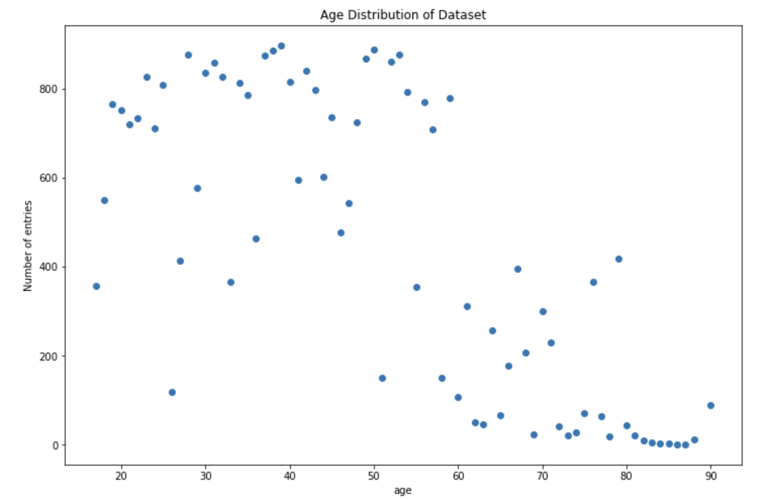
Age Distribution Of DataSet
Age ranges from 17 to 90 years with majority at 25 to 50 years old.

Slide 7
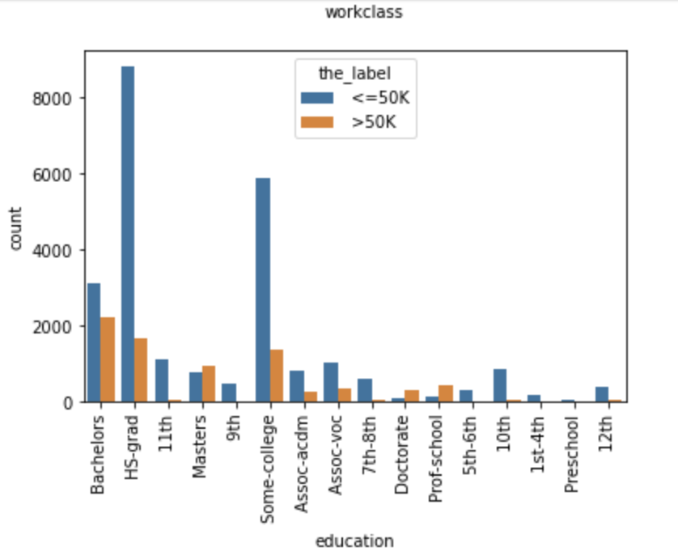
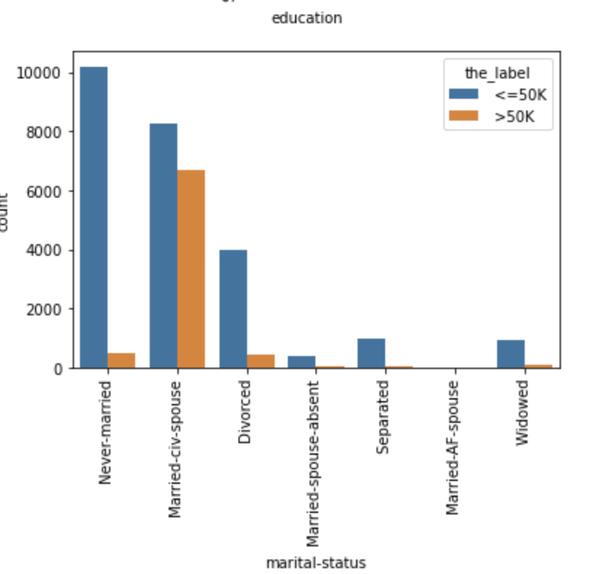
Category Breakdown of Annual Income
Education
Marital status

Slide 8
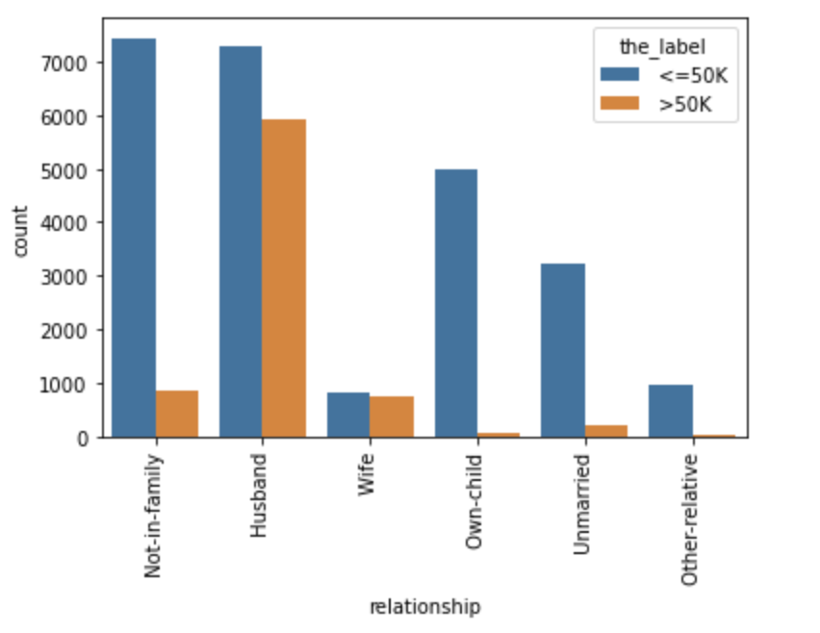
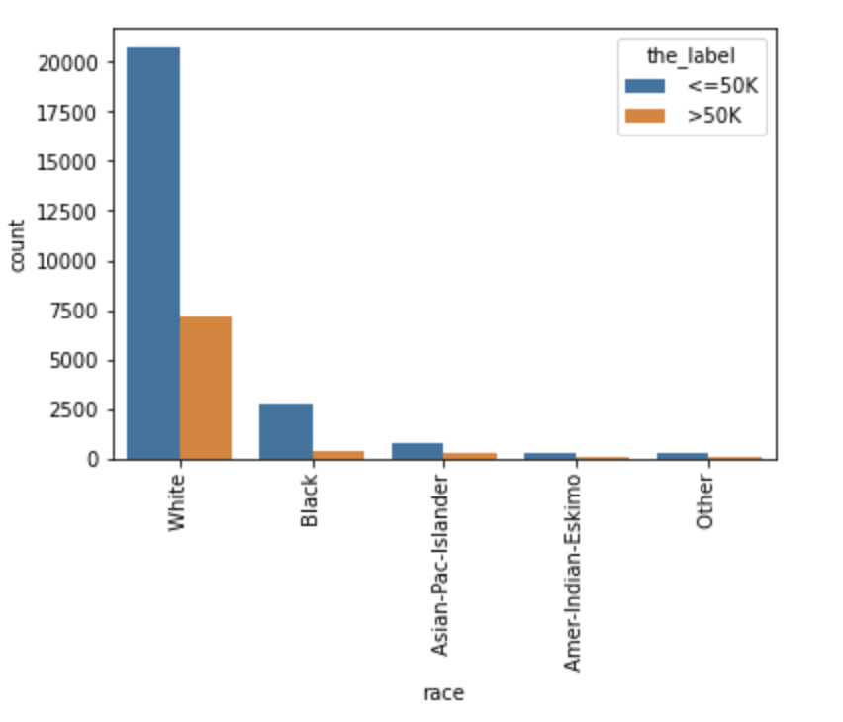
Category Breakdown of Annual Income Cont’d

Slide 9
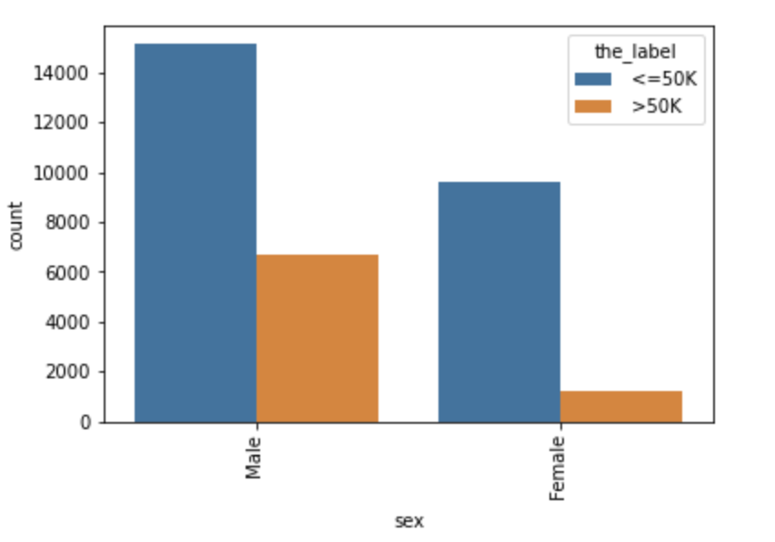
Category Breakdown of Annual Income Cont’d
Gender distribution

Slide 10
Models Used
Tree Classifier (gini criterion)
Decision Tree Classifier (entropy criterion)
Nearest k-NN algorithm
Logistic Regression

Slide 11
Data Pre-processing

Slide 12
INDEPENDENT VARIABLES
Independent values such as Education, workclass, education level, marital status, occupation, relationship, race and sex were categorical.
However, converted to binary using one-hot encoding.

Slide 13
DEPENDENT VARIABLE/ OUTPUT LABEL
OUTPUT LABEL USED/TO BE PREDICTED:
<=50K -----> ASSIGNED A 0
>50K -----> ASSIGNED A 1

Slide 14
TRAINING AND TESTING DATA
TRAINING DATA ------> 80%
TESTING DATA --------> 20%

Slide 15
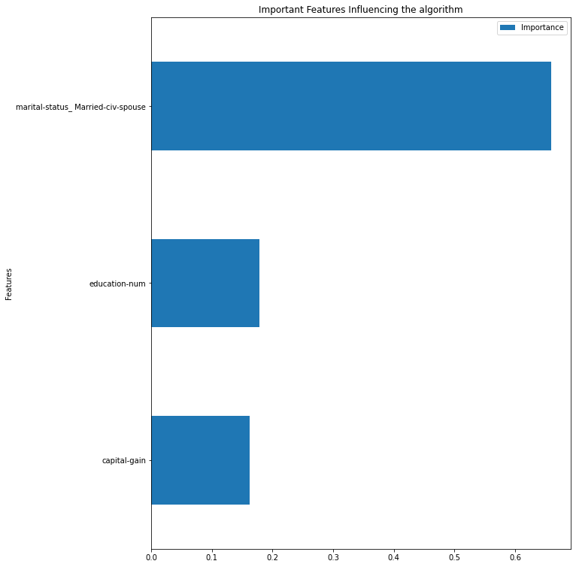
Using Decision Tree Classifier (gini criterion)
ACCURACY SCORE -----> 82.04%
PRECISION -----> 0----> 0.90
1----> 0.61
RECALL -----> 0 -----> 0.86
1------> 0.70
F1-SCORE ----> 0 ------> 0.88
1-----> 0.65
FEATURE IMPORTANCE
Married to a civilian spouse - 65.89%
Capital gain - 16.25%
Number of years spent in education - 17.86%

Slide 16
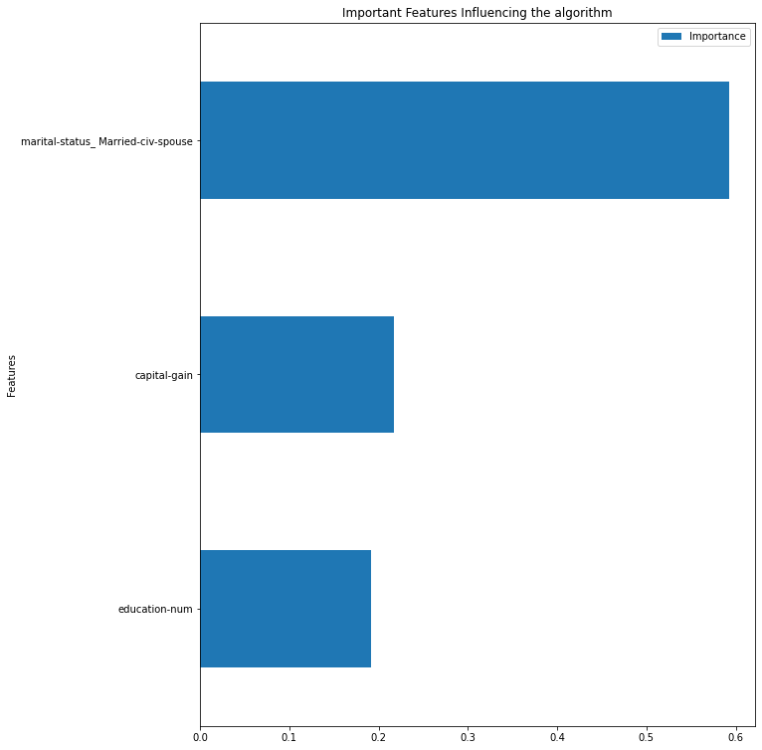
Using Decision Tree Classifier (entropy criterion)
ACCURACY SCORE ----------> 71.91%
PRECISION ---------> 0 ----------------> 0.94
1-----------------> 0.46
RECALL ---------> 0 ----------------> 0.67
1-----------------> 0.88
F1-SCORE ---------> 0 ----------------> 0.88
1-----------------> 0.60
FEATURE IMPORTANCE
Married to a civilian spouse - 59.21%
Capital gain - 21. 68%
Number of years spent in education - 19.11%

Slide 17
Nearest k-NN Algorithm
ACCURACY SCORE ----------> 84.85%
PRECISION ---------> 0 ----------------> 0.89
1-----------------> 0.70
RECALL ---------> 0 ----------------> 0.91
1-----------------> 0.65
F1-SCORE ---------> 0 ----------------> 0.90
1-----------------> 0.68

Slide 18
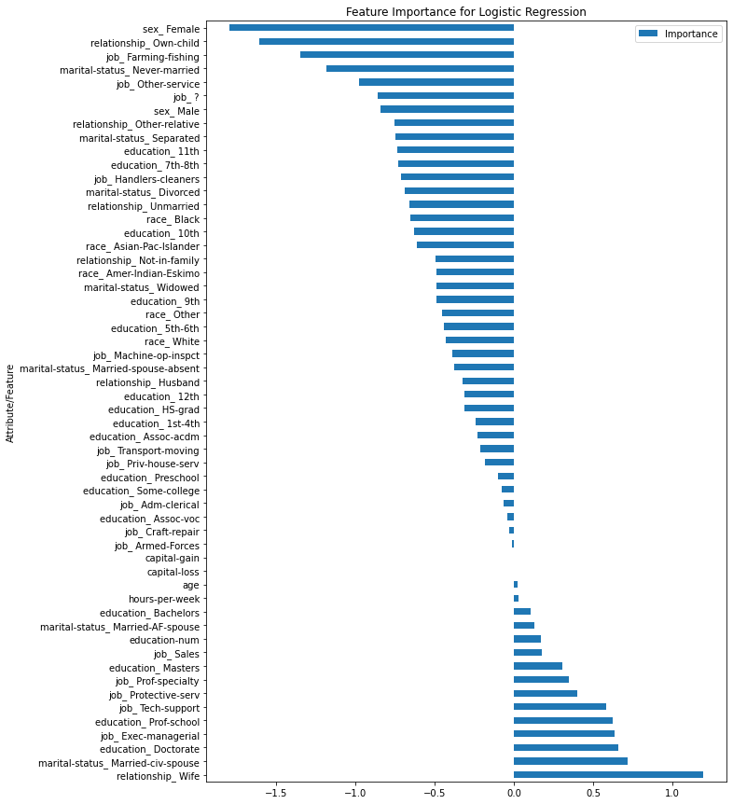
Using Logistics Regression
Classification Report
ACCURACY SCORE ----------> 80.79%
PRECISION ---------> 0 ----------------> 0.94
1-----------------> 0.57
RECALL ---------> 0 ----------------> 0.80
1-----------------> 0.85
F1-SCORE ---------> 0 ----------------> 0.86
1-----------------> 0.68

Slide 19
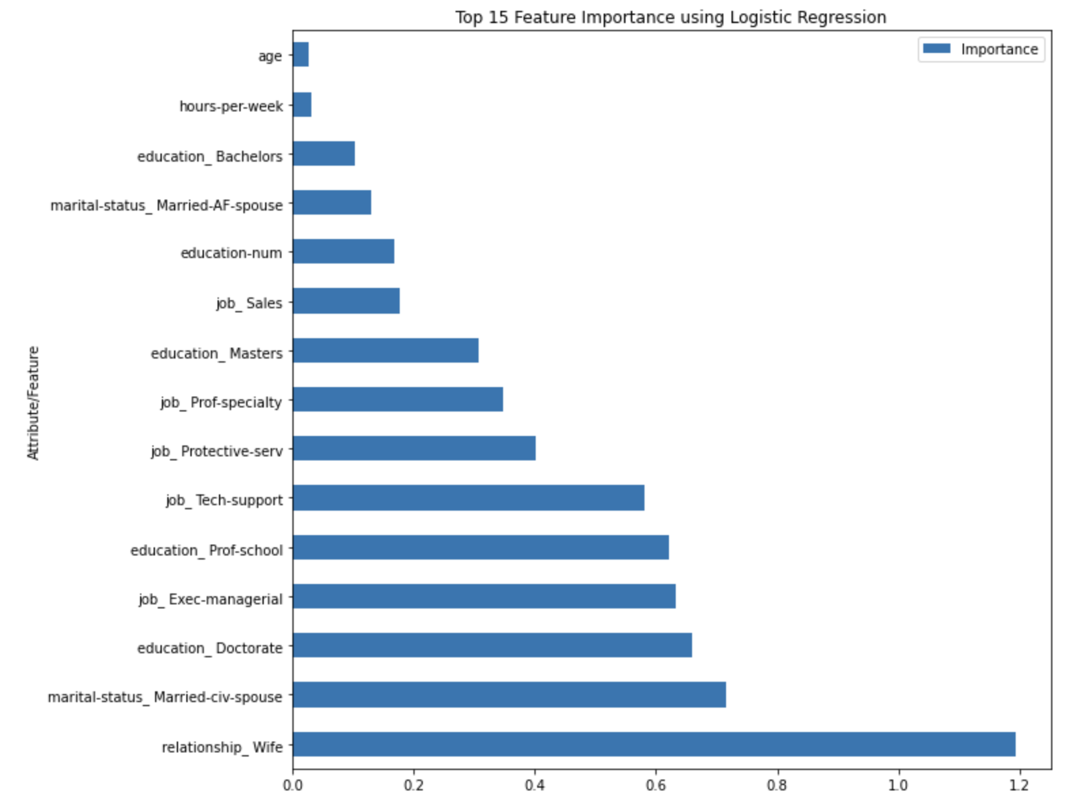
Logistic regression Cont’d
TOP 5 FEATURE IMPORTANCE
Relationship as a wife (1.19%)
Individuals who have civilian spouses (0.71%)
Individuals with Doctorate degrees (0.66%)
Individuals with managerial executive jobs (0.63%)
Individuals who have attended professional school (0.62%)

Slide 20
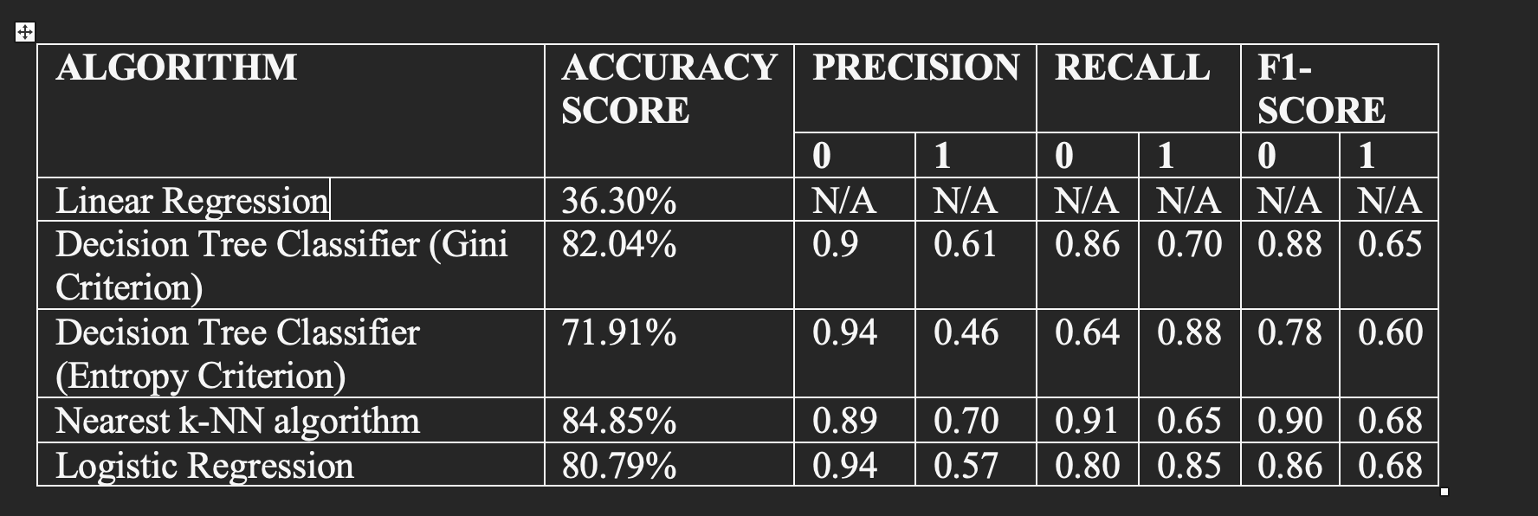
Summary

Slide 21
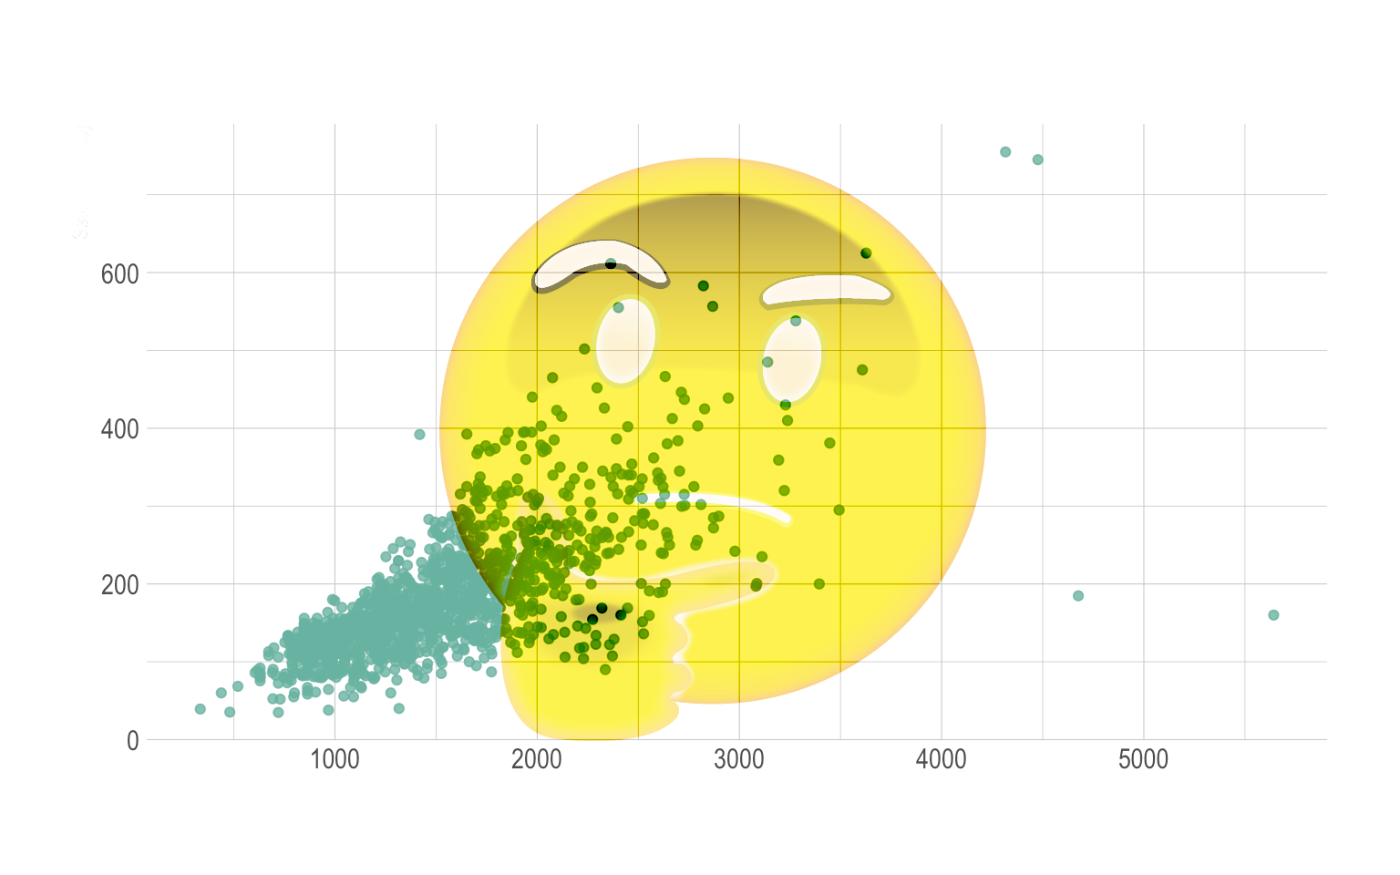
Analysis
What classification results in the most accurate data predictions?

Slide 22
Decision Tree Classifier (Gini Criterion)
Gives the highest precision out of algorithms selected
Nearest k-NN led to unbalanced data, invalidating this option (would otherwise be best algorithm)

Slide 23
Limiting Factors
Data was imbalanced.
About 26% of individuals whose annual income is above $50K and 74% whose annual income is below $50K.
The data was balanced before being placed in the algorithms.
Nearest kNN algorithm cannot accept this rebalanced data; the results from this algorithm are not reliable.

Slide 24
Conclusion
From the algorithm that was selected, being married to a civilian spouse has the greatest recorded influence on the algorithm’s prediction accuracy.
Some research suggests that the connection is possibly explained by high-income men and the decision to marry [and stay married] being influenced by financial stability.
For further reading:
https://www.ncbi.nlm.nih.gov/pmc/articles/PMC3955369/

Slide 25
THANK YOU!
QUESTIONS?

